Slide 1
Connected Device Studio Skill Transfer Workshop
Kevin Kao | Walker Lin | Andy Li
Microsoft IoT Innovation Center

Slide 2
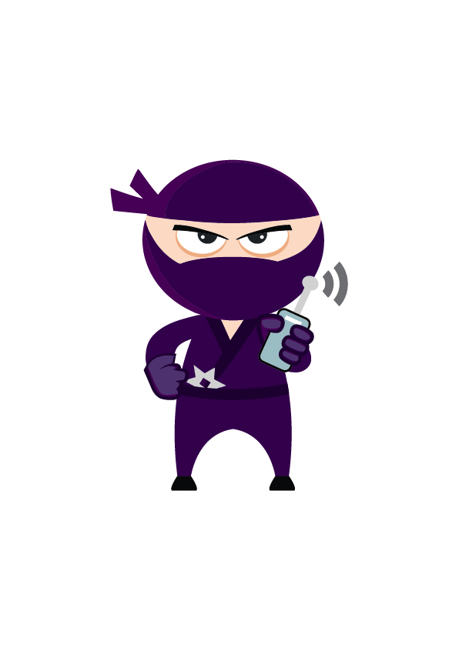
Content
Section 1 (4 hours)
Deploy Azure Services
Deploy DB and Data
Deploy API Service, Admin and SuperAdmin
Deploy Backend Tasks
First Company Onboarding
Remote Monitoring
Section 2 (4 ~6 hours)
DB Schema Overview
API Service (EF, Authentication and Class Model)
Admin & SuperAdmin (MVC and Call Flow)
Toolkit Device SDK & IoT Hub Receiver
Signal R & Message
Section 3 (4 hours)
Service Bus & OpsInfra, OpsAlarm, RoutineTask
Document DB
Service Fabric
Log & Operation and Trouble Shooting
Section 4 (4 hours)
How to Add New API
How to Add New Widget
How to Setup Staging Env

Slide 3
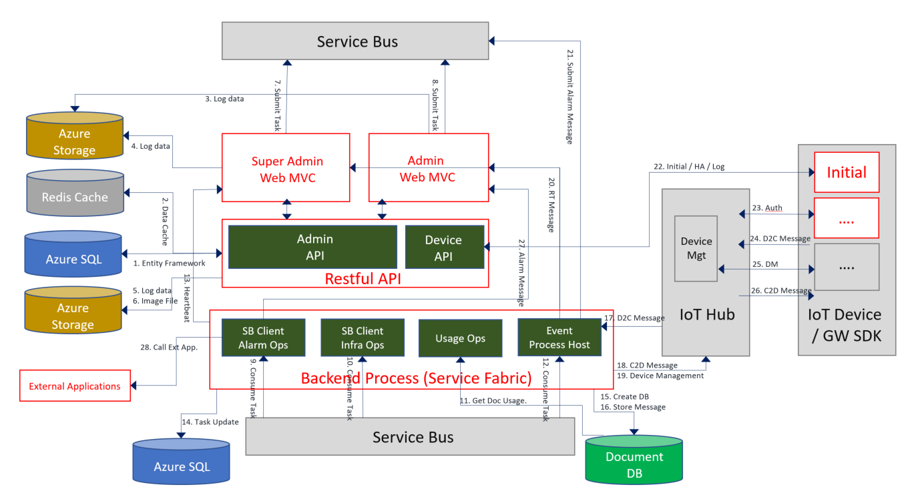
Architecture

Slide 4
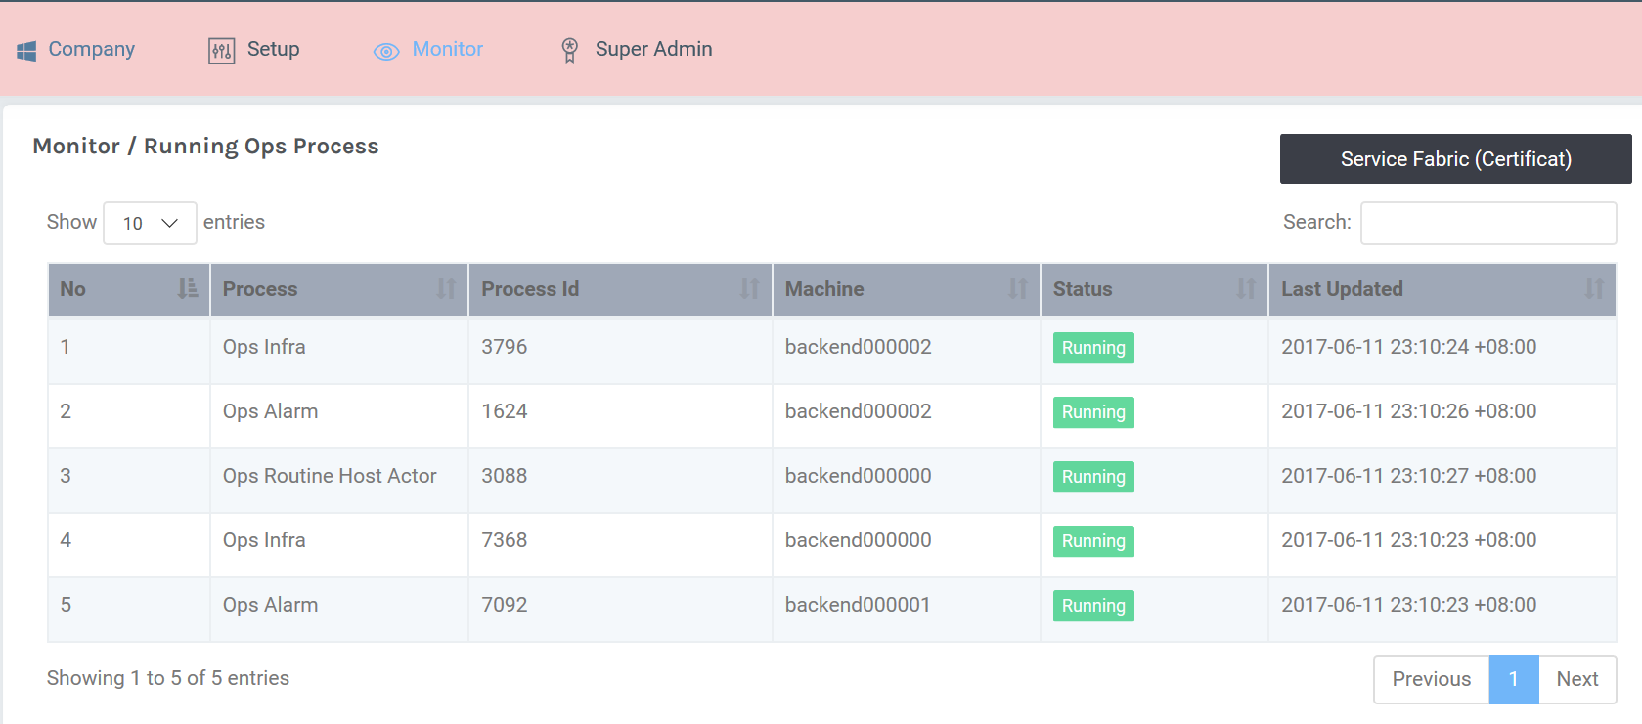
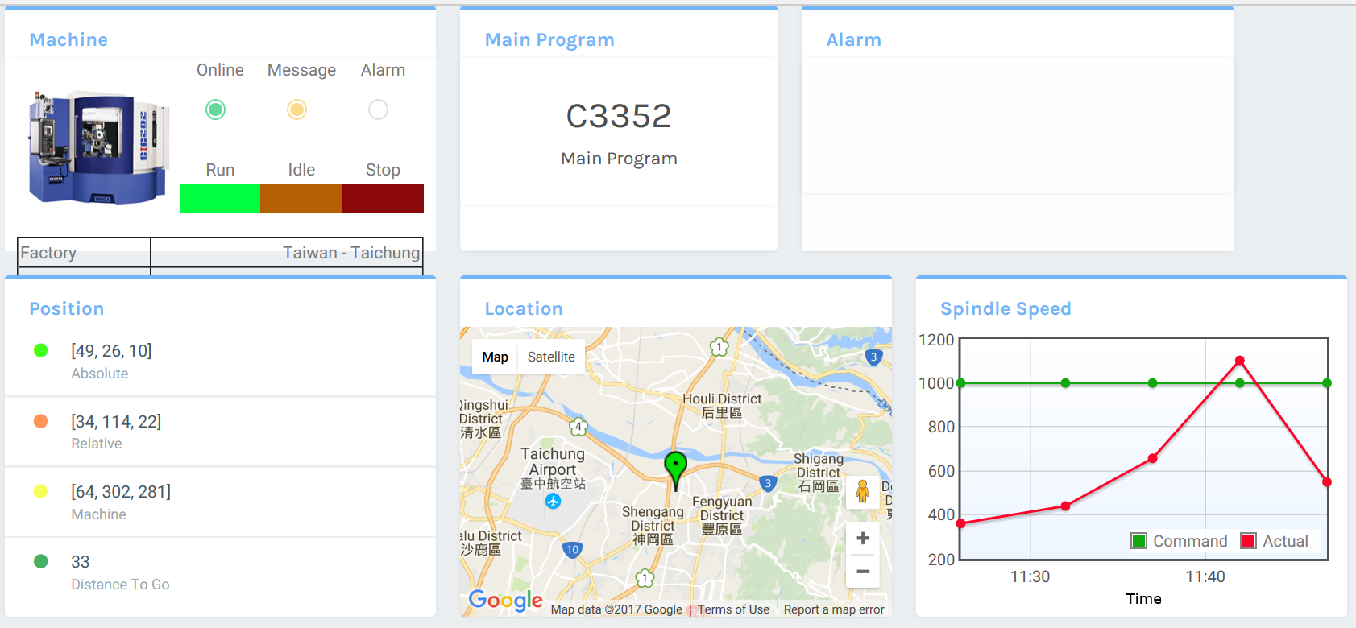
SignalR & Message
SignalR data feed in source: backend processes
Green Line: Heartbeat
Orange Line: Equipment Message
Red Line: Alarm Message
Admin Web
SuperAdmin Web
SB Client
Alarm Ops
SB Client
Infra Ops
Routine
Event
Process Host
Backend Process (Service Fabric)

Slide 5

Map Signal Hub Group to Company
Group A
Event Processor
Message (A,B,C)
Company A
Heartbeat (A,B,C)
Admin Web
Signal Hub
MessageFeedIn
WebAPI
Group B
Alarm (A,B,C)
Company B
Backend Process
Heartbeat
Group C
Company C
Group ID == Company ID
Security: Disable CORS (https://developer.mozilla.org/en-US/docs/Web/HTTP/Access_control_CORS)

Slide 6
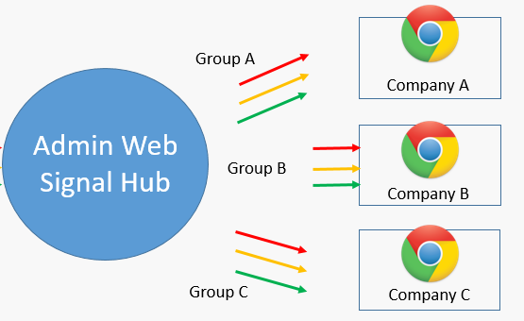
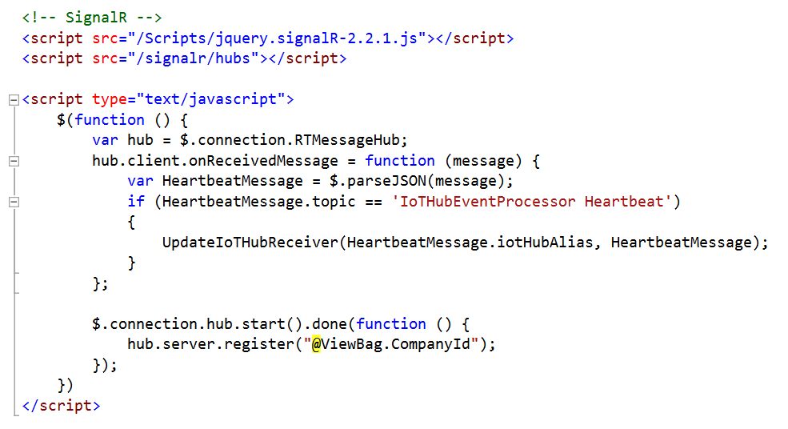
Code on HTML + JavaScript
Views/Monitor/IoTHubReceiver.cshtml
1. Load SignalR Hub JS.
2. Initial hub instance, map to server side instance: RTMessageHub .
3. Call Server method: Register with company ID

Slide 7
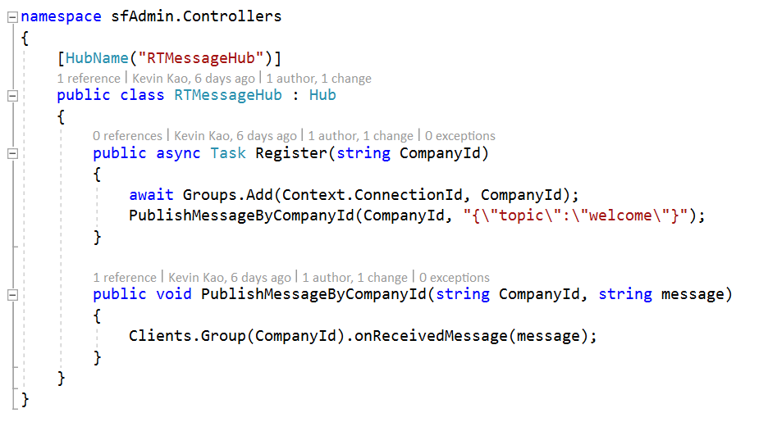
Code on ASP.NET MVC
0. Create Class: RTMessageHub
4. Add Client to Group by ID; Send welcome message to Client.

Slide 8
Code on HTML + JavaScript
Views/Monitor/IoTHubReceiver.cshtml
5. Receive message from Server

Slide 9
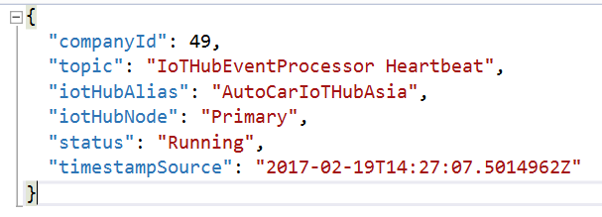
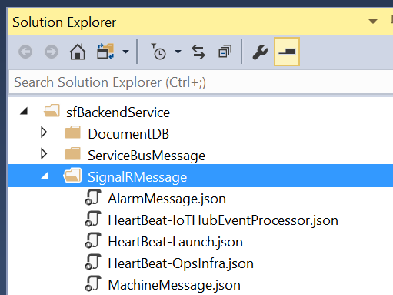
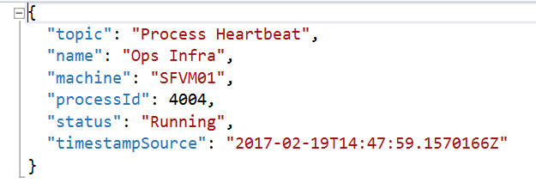
SignalR Message: HeartBeat

Slide 10
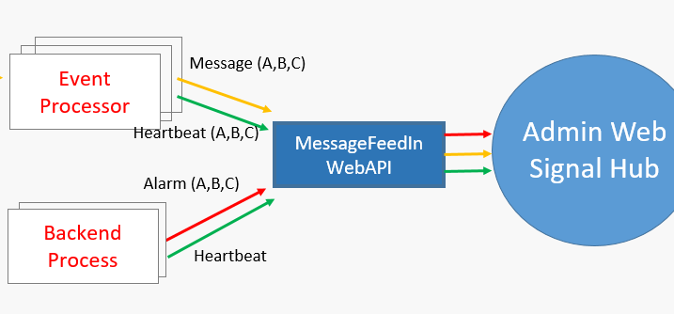
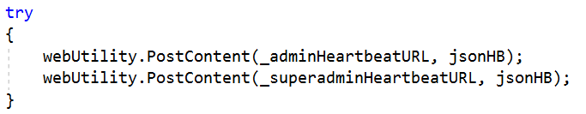
HeartBeat Sender
IoTHubEventProcessor/App.config
IoTHubEventProcessor/Program.cs

Slide 11
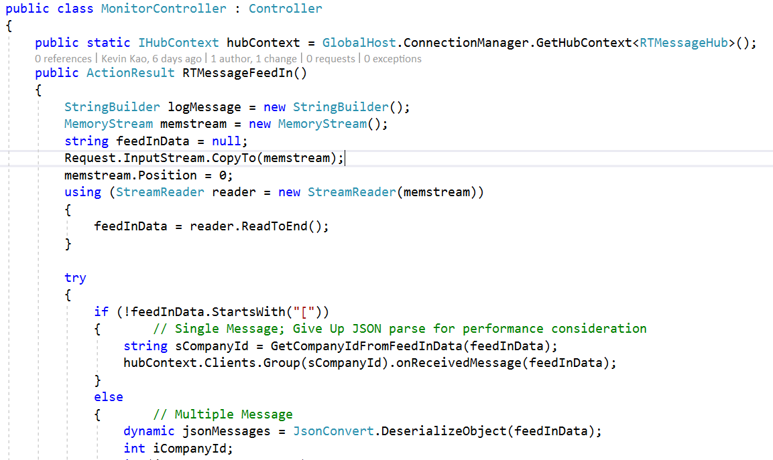
Message Feed In Web API
1. Get RTMessageHub running instance.
2. Get company ID, send feed in message to Group.

Slide 12
Heartbeat, Message and Alarm
SignalR doesn’t understand heartbeat, Message and Alarm
SignalR just broadcast data into different Group by company ID
Different type of data are handle by View of MVC.
Admin Web
SuperAdmin Web
SB Client
Alarm Ops
SB Client
Infra Ops
Routine
Event
Process Host
Backend Process (Service Fabric)

Slide 13
SignalR Pages
Project | Pages | Type | Source
AdminWeb | Monitor/IoTHubReceiver | Heartbeat | Event Processor Host
 | Dashboard/Index | Message & Alarm | Event Processor Host AlarmOps
 | Dashboard/FactoryDashboard | Message & Alarm | Event Processor Host AlarmOps
 | Dashboard/EquipmentClassDashboard | Message & Alarm | Event Processor Host AlarmOps
SuperAdminWeb | Monitor/IoTHubReceiver | Heartbeat | Event Processor Host
 | Monitor/RunningOpsProcess | Heartbeat | AlarmOps InfraOps Routine

Slide 14
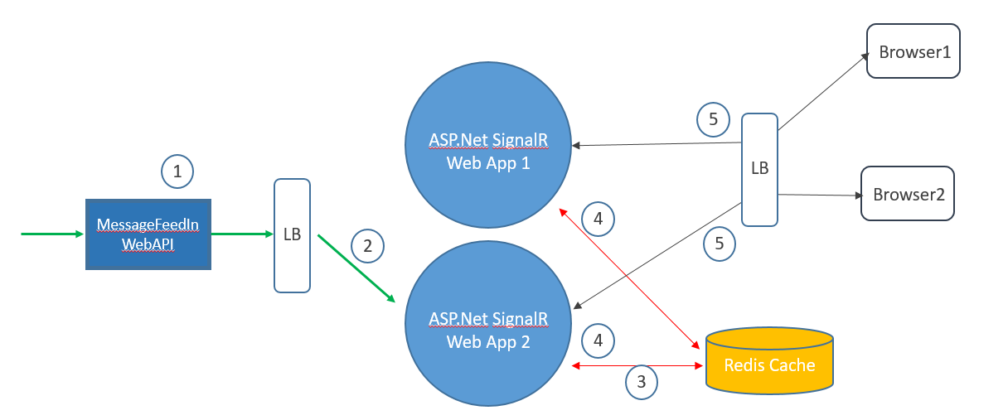
Scale SignalR with Redis Cache
SignalR may become a performance bottleneck where more and more company and device connected.
Design a scalable AdminWeb (SignalR), and to keep data consistent on each SignalR Hub.

Slide 15
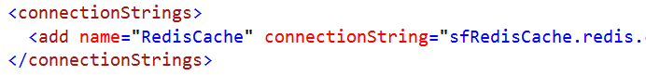
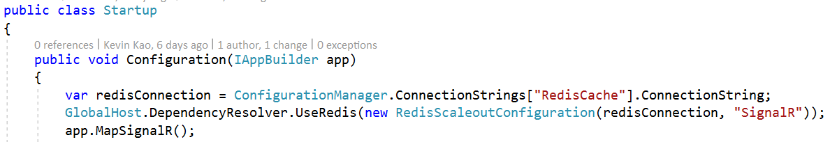
Config SignalR with Redis Cache
Define Redis Cache on Web.config
Startup.cs
Get Redis Cache connection string.
Setup SignalR Hub(GlobalHost) by using Redis Cache. (Redis Publish/Subscribe)

Slide 16
Data broadcasting to multiple SignalR Hubs
Red Line: both SignalR Hub connected to Redis Cache.
Message Feed In API send a data to WebApp/SignalR Hub.
By LB policy, the WebApp 2 be selected.
By setup, SignalR Hub(2) get the data, and publish the data to Redis Cache.
By setup, both SignalR Hub(1) and SignalR Hub(2) received data from Redis Cache.
At beginning, browser 1 connected to SignalR Hub(1) and browser 2 connected to Signal Hub(2); now both browsers receive same data from each SignalR Hub.

Slide 17
Section 2 SignalR and Message End
Kevin Kao | Walker Lin | Andy Li
Microsoft IoT Innovation Center

